Slide 1

AGE 310: Instrumentation and Measurements
Lecture 14: Machine Vision in Agriculture
Instructor: Dr. Kadeghe Fue
Department of Agricultural Engineering
Sokoine University of Agriculture (SUA)

Slide 2


Recap & Objectives
Recap: Lecture 13
Lecture 14 Objectives
We discussed Agricultural Drones (UAVs) and remote sensing using aerial platforms.
Define Machine Vision vs. Computer Vision.
Understand the EM Spectrum in sensing.
Master the Image Processing Pipeline (Acquisition → Segmentation → Classification).
Analyze applications: Weed Detection and Fruit Grading.

Slide 3

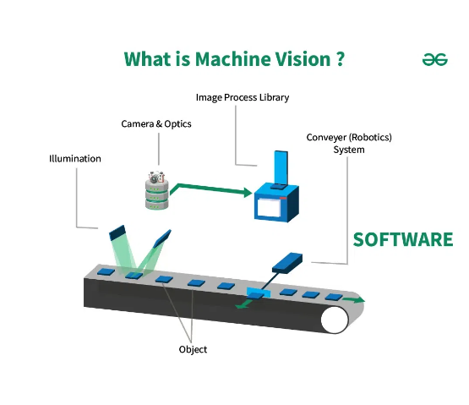
What is Machine Vision?
Machine Vision (MV) is the technology used to provide imaging-based automatic inspection and analysis for applications such as automatic inspection, process control, and robot guidance.
In Agriculture, it gives the "eyes" to our robots, allowing them to differentiate a crop from a weed or a ripe tomato from a green one.

Slide 4
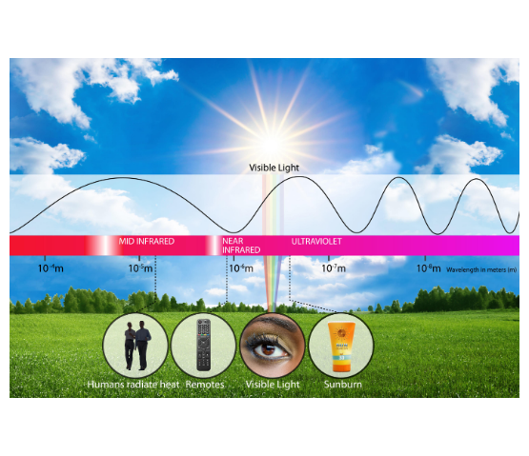
The Electromagnetic Spectrum
Seeing the Invisible
Human eyes only see the Visible Spectrum (400-700nm).
Agricultural cameras often look beyond:
Near Infrared (NIR): Plant health (NDVI).
Thermal (LWIR): Water stress / Temperature.
UV: Fluorescence in some bacteria/fungi.

Slide 5







Components of a Vision System
Lighting
Camera
Processor
The most critical part. Consistent lighting (LEDs) removes shadows and highlights key features.
Captures the light. Contains the Lens (focus) and Sensor (CCD/CMOS).
The Computer (e.g., Raspberry Pi, Jetson Nano) that runs the algorithms to interpret the image.

Slide 6
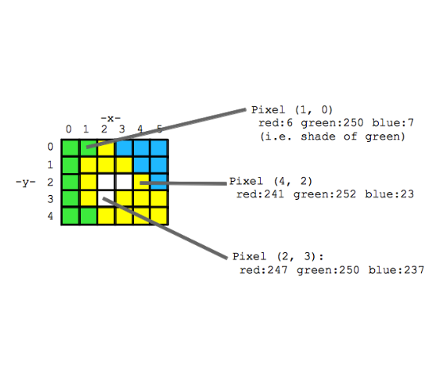
Digital Image Fundamentals
The Pixel
An image is just a grid (matrix) of numbers.
RGB Image: Consists of 3 channels (Red, Green, Blue).
Each pixel has 3 values (0-255).
Example: R=255, G=0, B=0 is Pure Red.
Resolution: Number of pixels (e.g., 1920 x 1080).

Slide 7


The Image Processing Pipeline
The step-by-step process to go from "Picture" to "Decision".
1. Pre-processing
2. Segmentation
Cleaning the image. Resizing, converting to Grayscale, removing noise (Gaussian Blur).
Separating the object of interest (Plant) from the background (Soil).
3. Feature Extraction
4. Classification
Measuring properties: Area, Perimeter, Color, Texture.
Deciding what it is: "Weed" or "Crop"? "Ripe" or "Unripe"?

Slide 8
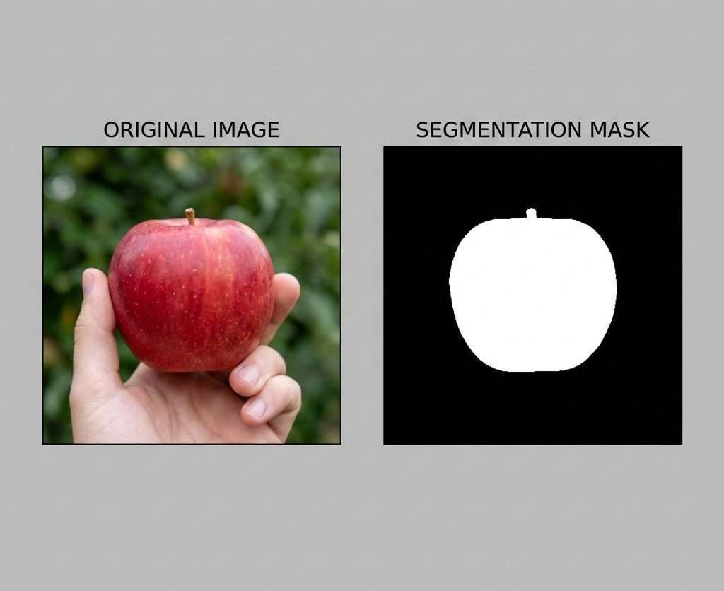

Segmentation: Thresholding
Green from Brown
The simplest way to find plants is the Excess Green Index (ExG).
If ExG > Threshold, the pixel is Plant (White). Otherwise, it is Soil (Black).
This creates a Binary Mask.

Slide 9







Feature Extraction
Morphology (Shape)
Color
Texture
Area, Circularity, Aspect Ratio.
Average R, G, B values or Hue.
Smoothness, coarseness.
Ex: Maise leaves are long (low circularity), some weeds are round.
Ex: Nitrogen deficient maize is pale yellow-green.
Ex: Detecting wrinkled skin on fruits.

Slide 10
Classification: Making Decisions
Rule-Based
Machine Learning / AI
Simple Logic.
Training a model (Neural Network) on thousands of images.
IF (Red > 200) THEN "Ripe Tomato"
The computer "learns" features automatically.
Fast, easy to understand, but brittle.
Robust, handles complex scenes, requires lots of data.

Slide 11
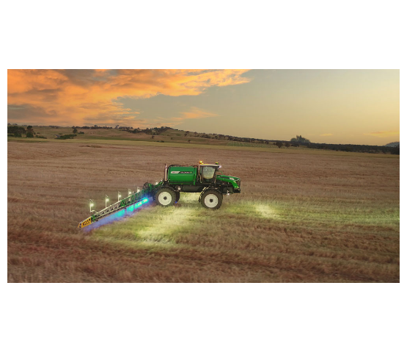
Application 1: Smart Weeding
See & Spray
Cameras mounted on a tractor boom scan the field.
Green-on-Brown: Detects any green plant on bare soil (Fallow).
Green-on-Green: Uses AI to distinguish weeds from crops inside the row.
The system triggers a solenoid valve to spray only the weed.

Slide 12
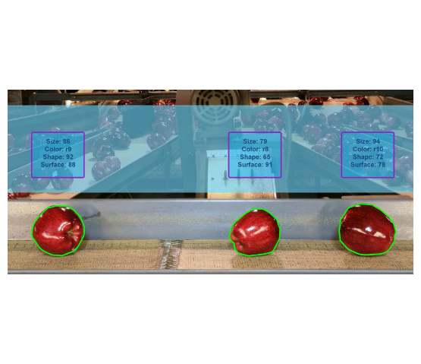
Application 2: Fruit Grading
Post-Harvest Automation
Fruits move on a conveyor belt under a camera box.
Size: Calculated from pixel area.
Color: Sorting into "Premium Red", "Standard", "Processing".
Defects: Detecting bruises or cuts.
Air jets blow the fruit into the correct bin.

Slide 13
Application 3: Disease Detection
Early Warning
Benefits
Analyzing leaf spots on smartphones (e.g., Nuru App for Cassava).
Allows farmers to identify diseases early and remove infected plants before they spread to the whole field.
The AI model identifies the specific pattern of Mosaic Disease or Brown Streak.

Slide 14






Challenges in Field Vision
Uncontrolled Lighting
Occlusion
Processing Speed
Shadows from clouds or direct sun glare can confuse the camera algorithms.
Leaves overlapping each other hide fruits or weeds from view.
Tractors move fast. The system must process images in milliseconds (Real-Time).

Slide 15

Discussion & Questions
End of Lecture 14
Assignment: Take a photo of a plant leaf against a white paper. Use Python (OpenCV) or an online tool to separate the green pixels and calculate the leaf area in pixels.
Dr. Kadeghe Fue | AGE 310 | SUA

Slide 16






Image Sources
https://upload.wikimedia.org/wikipedia/en/c/c1/SUA.png
Source: wikipedia.org
https://media.geeksforgeeks.org/wp-content/uploads/20240514175305/What-is-Machine-Vision-01.webp
Source: www.geeksforgeeks.org
https://www.nist.gov/sites/default/files/styles/2800_x_2800_limit/public/images/2021/06/01/EM_illustration_HR_FINAL.jpg?itok=HnKDjw--
Source: www.nist.gov
https://web.stanford.edu/class/cs101/image-diagram2.png
Source: web.stanford.edu
https://lh7-us.googleusercontent.com/docsz/AD_4nXetb7ylqp5xps2kLHQI7vETCDTewLjQaUx1gWq6xqhFH2E5X2FYSs66vP1xuPUEBZSu_e_dqB9q1s2vQo05vU1pdgHLJo6l4NSI5KQMjXzXK1QnLZpgARupA_QTQTnQKAkeD2aezMCebGNMB3SKB8WbUzfvLY3KRj1T-bKjQibUW6Lms1B-oQ?key=3d_z5dHJgVZSFfqLscQSfw
Source: blog.roboflow.com
https://afdj.com.au/wp-content/uploads/2022/04/Goldacres-Weedetect-in-action-at-dusk-web.jpg
Source: afdj.com.au

Slide 17

Image Sources
https://bitrefine.group/images/1920x870/automated_apple-sorting_1920x870.jpg
Source: bitrefine.group

